Slide 1
System Engineering
Lecturer: Ngo Huy Bien
Software Engineering Department
Faculty of Information Technology
VNUHCM - University of Science
Ho Chi Minh City, Vietnam
nhbien@fit.hcmus.edu.vn

Slide 2

Objectives

Slide 3

Contents
Information system
System engineering

Slide 4

References
Antoni Olive (2007). Conceptual Modeling of Information Systems.
Roger S. Pressman and Bruce R. Maxim (2015). Software Engineering - A Practitioner’s Approach. 8th Edition. McGraw-Hill.

Slide 5

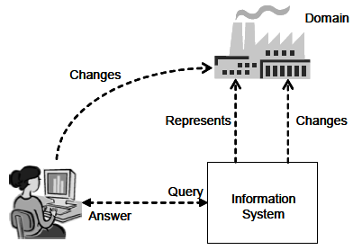
Information System [1]
An information system is a designed system that collects, stores, processes, and distributes information about the state of a domain.
A system is therefore considered to have three main functions:
Memory: to maintain a representation of the state of a domain.
Informative: to provide information about the state of a domain.
Active: to perform actions that change the state of a domain.

Slide 6
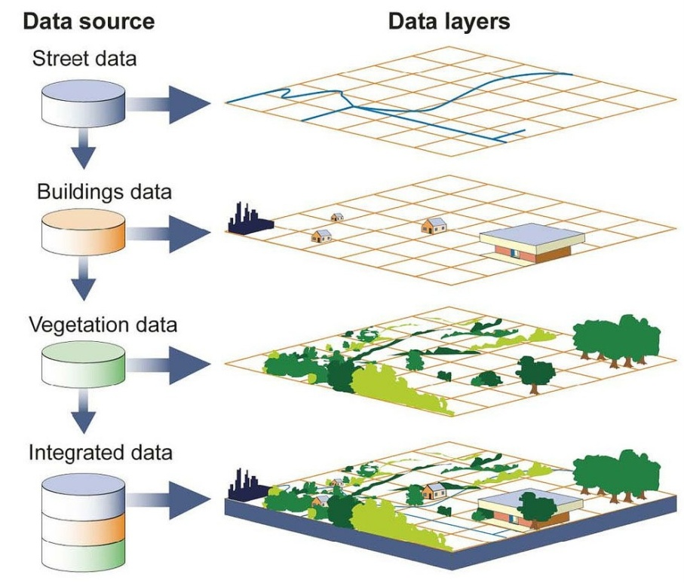

Geographic Information System

Slide 7
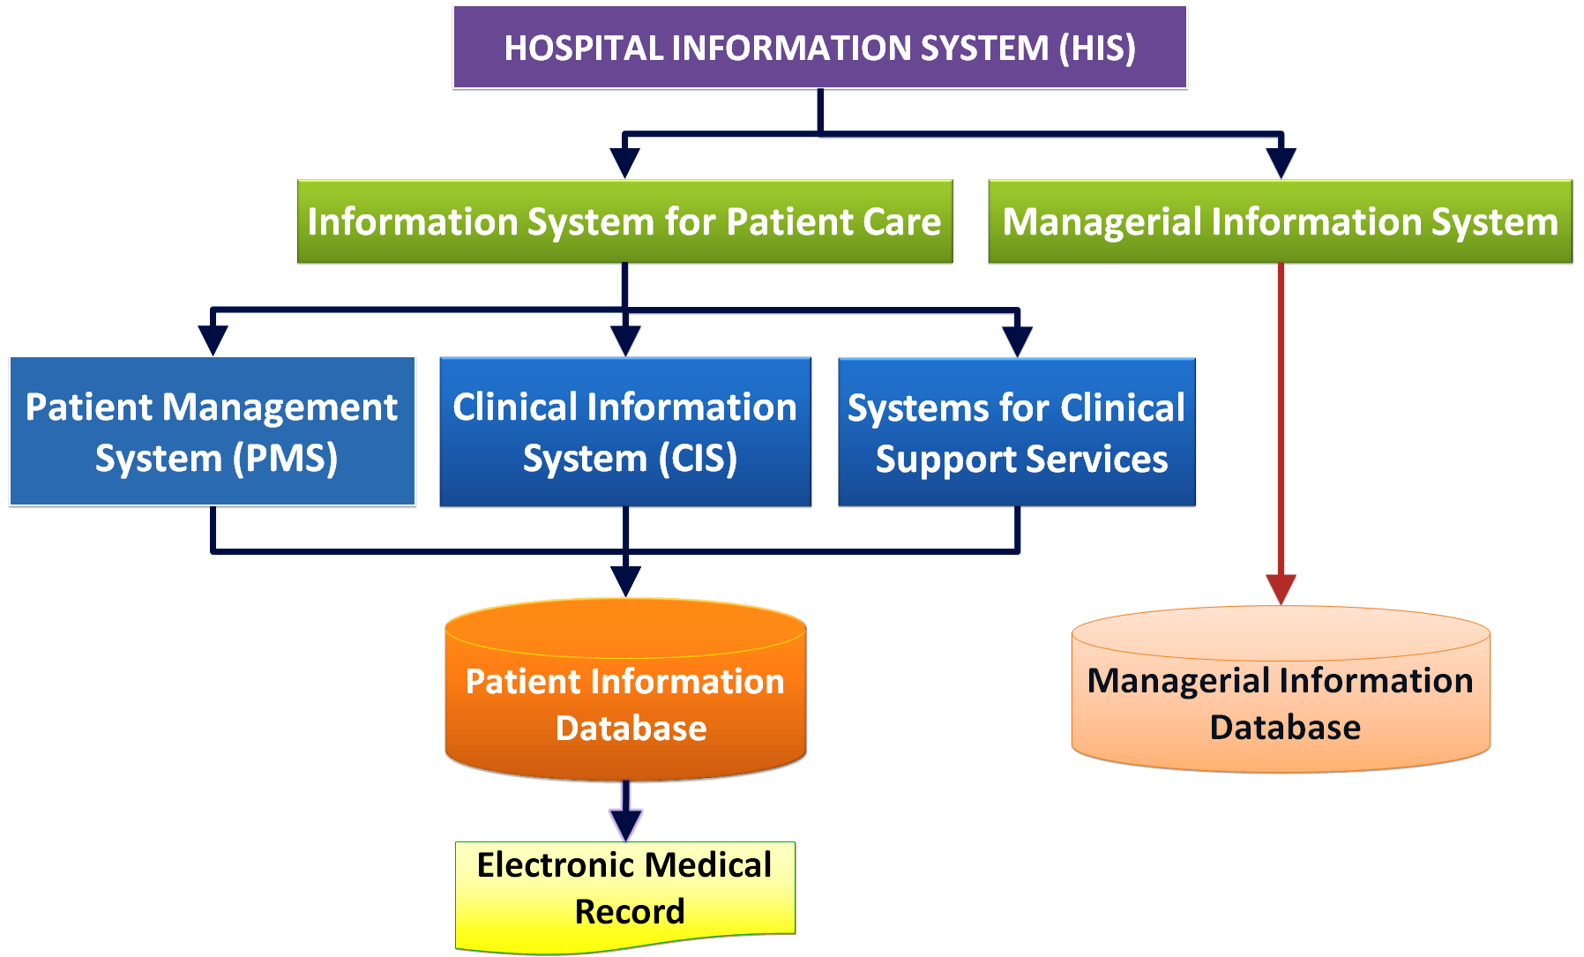

Hospital Information System

Slide 8
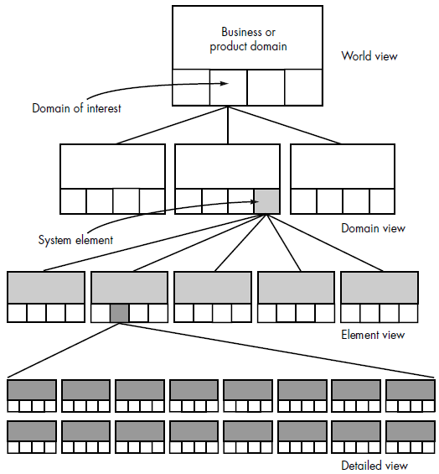
System Engineering Hierarchy [2]

Slide 9
Hierarchy Explanation
The world view (WV) is composed of a set of domains (Di), which can each be a system or system of systems in its own right:
WV = {D1, D2, D3, . . . , Dn}
Each domain is composed of specific elements (Ej) each of which serves some role in accomplishing the objective and goals of the domain or component: Di = {E1, E2, E3, . . . , Em}
Finally, each element is implemented by specifying the technical components (Ck) that achieve the necessary function for an element: Ej = {C1, C2, C3, . . . , Ck}
In the software context, a component could be a computer program, a reusable program component, a module, a class or object, or even a programming language statement.

Slide 10
Business Process Engineering
The goal of business process engineering (BPE) is to define architectures that will enable a business to use information effectively.
Three different architectures must be analyzed and designed within the context of business objectives and goals:
The data architecture provides a framework for the information needs of a business or business function.
The application architecture encompasses those elements of a system that transform objects within the data architecture for some business purpose.
The technology infrastructure provides the foundation for the data and application architectures.

Slide 11
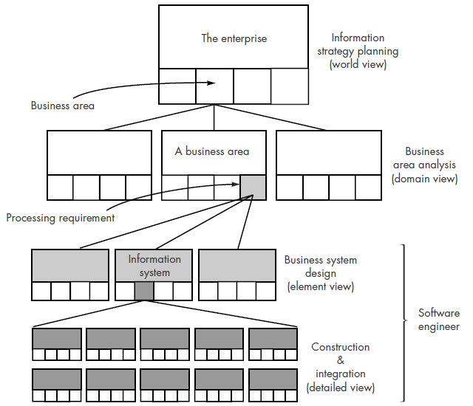
Information Strategy Planning (ISP)

Slide 12
Business Area Analysis
BAA is concerned with identifying in detail data (in the form of entity [data object] types) and function requirements (in the form of processes) of selected business areas [domains] identified during ISP and ascertaining their interactions (in the form of matrices).
It is only concerned with specifying what is required in a business area.
BAA defines data objects, their relationships, and how data flow.
Object: Customer
Attributes:
name
company name
job classification and purchase authority
business address and contact information
product interest(s)
past purchase(s)
date of last contact
status of contact

Slide 13
Product Engineering
The goal of product engineering is to translate the customer’s desire for a set of defined capabilities into a working product.
The architecture encompasses four distinct system components: software, hardware, data (and databases), and people.
A support infrastructure is established and includes the technology required to tie the components together and the information (e.g., documents, CD-ROM, video) that is used to support the components.
The world view is achieved through requirements engineering.

Slide 14
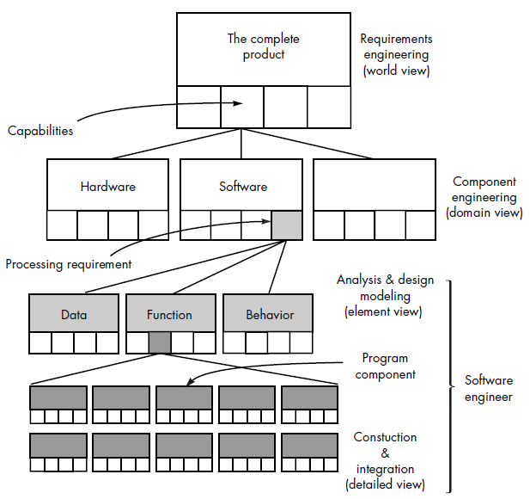
Product Engineering Hierarchy

Slide 15

Thank You & See You Again

